Slide 1
Social
Computing

Slide 2
CHAPTER OUTLINE
Web 2.0
Fundamentals of Social Computing in Business
Social Computing in Business: Shopping
Social Computing in Business: Marketing

Slide 3

Disappearing Images
Describe the advantages and disadvantages of Snapchat to its users. Provide specific examples of both to support your answer.
Do you think that Snapchat can become profitable (i.e., survive) in the marketplace? Why or why not? Support your answer with specific examples.
How will the Snapchat breach affect marketers who are considering using the app in their campaigns?
Should Snapchat’s founders have sold the service to Facebook or Google? Why or why not? If you were the founder of Snapchat, would you have accepted one of these offers? Why or why not?

Slide 4
’S ABOUT BUSINESS 8.1
Brian Krebs Blogs on Information Security
List various ways in which Krebs can make money from his blog.
You are the Chief Security Officer for a company. How would you incorporate Krebs’s blog into your security efforts?

Slide 5
Facebook Commerce(The Problem)
With some 1 billion members, Facebook is a very desirable Web site on which to advertise, sell, and conduct other social commerce activities.
Social commerce is the delivery of electronic commerce activities and transactions through social computing.
With its size, Facebook offers opportunities for companies to reach out to customers and conduct business transactions.
What is the best way to take advantage of Facebook’s size—as well as its existing customer base—to do business?

Slide 6
Facebook Commerce (The Solutions)
Facebook commerce (or f-commerce) refers to commerce executed on, or influenced by, the Facebook platform.
Two major types of f-commerce are emerging:
Commerce-on Facebook
Commerce-off Facebook.

Slide 7
Facebook Commerce (The Solutions)
Commerce-on Facebook:
Commerce-on Facebook is a type of electronic commerce in which the transaction occurs completely inside Facebook.
Vendors create Facebook stores for their customers, who conduct transactions without leaving Facebook.

Slide 8
Facebook Commerce (The Solutions)
Commerce-on Facebook:
Commerce-on Facebook is a type of electronic commerce in which the transaction occurs completely inside Facebook.
Vendors create Facebook stores for their customers, who conduct transactions without leaving Facebook.

Slide 9
Facebook Commerce (The Solutions)
Commerce-on Facebook:
The P&G Pampers F-Store, powered by Amazon WebStore, sold 1,000 diaper packs directly to consumers in less than one hour after the store “went live” on Facebook. •
ASOS, Europe’s first fully integrated F-store, makes it possible for consumers to complete purchases without ever leaving Facebook. •

Slide 10
Facebook Commerce (The Solutions)
Commerce-off Facebook:
Commerce-off Facebook takes advantage of Facebook’s Open Graph, which allows shoppers to sign in to Facebook from any Web site with any computing device (e.g., laptop, netbook, phone).

Slide 11
Facebook Commerce (The Results)
Many Facebook users have become so accustomed to Facebook’s aggressive data-sharing policies that they automatically assume the worst.
In fact, studies have shown that a majority of Facebook users have concerns about Facebook’s privacy and security.
Experienced e-commerce managers also perceive problems with Facebook itself. Facebook has relatively slow page loads and a smaller page size due to its advertising and navigation.

Slide 12
Facebook Commerce (The Results)
Regardless of the pros and cons of f-commerce, however, modern businesses must acknowledge one overwhelming fact: Facebook is where the customers are, and they should be able to buy wherever and whenever they like.
Today, almost 70 percent of companies conduct transactions on or through Facebook.

Slide 13
Questions
What are the advantages for a business of conducting commerce on Facebook? The disadvantages?

Slide 14
What We Learned from This Case?
Humans are social individuals; therefore, human behavior is innately social.
Humans typically orient their behavior around other members of their community.
As a result, people are sensitive to the behavior of people around them, and many of their decisions are influenced by their social context.
Traditional information systems support organizational activities and business processes and concentrate on cost reductions and productivity increases. A variation of this traditional model, social computing, is a type of IT that combines social behavior and information systems to create value

Slide 15
Web 2.0
AJAX
Tagging
Folksonomies
Geotagging
Really Simple Syndication (RSS)
Blogs
Notes:
AJAX: is a Web development technique that enables users to reload portions of Web pages with fresh data instead of having to reload the entire Web page.
Tagging: a keyword or term that describes a piece of information—for example, a blog, a picture, an article, or a video clip. Tagging allows users to place information in multiple, overlapping associations rather than in rigid categories.
Folksonomies: user generated classifications that use tags to categorize and retrieve Web pages, photos, videos, and other Web content.
Geotagging: a specific form of tagging referring to tagging information on maps (example: Google Maps allows users to add pictures and information, such as restaurant or hotel ratings, to maps).
Blog: (short for weblog) a personal Web site, open to the public, in which the site creator expresses his or her feelings or opinions via a series of chronological events.

Slide 16
Web 2.0
AJAX: is a Web development technique that enables users to reload portions of Web pages with fresh data instead of having to reload the entire Web page.
Tagging: a keyword or term that describes a piece of information—for example, a blog, a picture, an article, or a video clip. Tagging allows users to place information in multiple, overlapping associations rather than in rigid categories.
Folksonomies: user generated classifications that use tags to categorize and retrieve Web pages, photos, videos, and other Web content.
Geotagging: a specific form of tagging referring to tagging information on maps (example: Google Maps allows users to add pictures and information, such as restaurant or hotel ratings, to maps).
Blog: (short for weblog) a personal Web site, open to the public, in which the site creator expresses his or her feelings or opinions via a series of chronological events.
Notes:
AJAX: is a Web development technique that enables users to reload portions of Web pages with fresh data instead of having to reload the entire Web page.
Tagging: a keyword or term that describes a piece of information—for example, a blog, a picture, an article, or a video clip. Tagging allows users to place information in multiple, overlapping associations rather than in rigid categories.
Folksonomies: user generated classifications that use tags to categorize and retrieve Web pages, photos, videos, and other Web content.
Geotagging: a specific form of tagging referring to tagging information on maps (example: Google Maps allows users to add pictures and information, such as restaurant or hotel ratings, to maps).
Blog: (short for weblog) a personal Web site, open to the public, in which the site creator expresses his or her feelings or opinions via a series of chronological events.

Slide 17
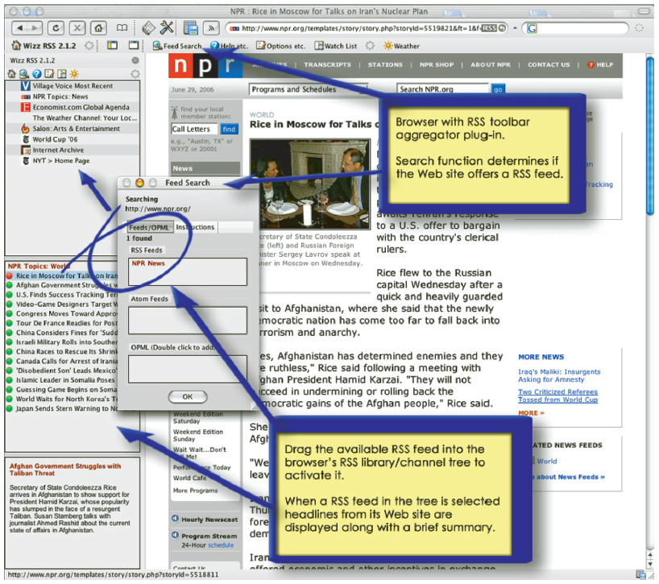
Figure 8.1: Web Site of National Public Radio with RSS Toolbar

Slide 18

8.1
Web 2.0 (continued)
Microblogging
Wikis
Social Networking Web Sites
Enterprise Social Networks
Mashups
Notes:
Microblogging: a form of blogging that allows users to write short messages (or capture an image or embedded video) and publish them (Example: Twitter).
Wiki: a Web site made up entirely of user generated content (Example: Wikipedia.com).
Social Network: a social structure composed of individuals, groups, or organizations linked by values, visions, ideas, financial exchange, friendship, kinship, conflict, or trade.
Social Networking: refers to activities performed using social software tools (e.g., blogging) or social networking features (e.g., media sharing).
Social Graph: the map of a single member of a social network comprised of all relevant links or connections among the greater social network.
Social Capital: refers to the number of connections an individual person has within and between social networks.
Social Networking Web Sites: web sites that allow participants to create their own profile page for free allowing them to post blog entries, pictures, video, music and/or share ideas.
Enterprise Social Networks: business-oriented social networks (public or private) designed to support networking and community building, social collaboration, social publishing, Social intelligence and social analytics.
Mashups: a Web site that takes different content from a number of other Web sites and mixes them together to create a new kind of content.

Slide 19
Web 2.0(continued)
Microblogging: a form of blogging that allows users to write short messages (or capture an image or embedded video) and publish them (Example: Twitter).
Wiki: a Web site made up entirely of user generated content (Example: Wikipedia.com).
Social Network: a social structure composed of individuals, groups, or organizations linked by values, visions, ideas, financial exchange, friendship, kinship, conflict, or trade.
Social Networking: refers to activities performed using social software tools (e.g., blogging) or social networking features (e.g., media sharing).
Social Graph: the map of a single member of a social network comprised of all relevant links or connections among the greater social network.
Notes:
Microblogging: a form of blogging that allows users to write short messages (or capture an image or embedded video) and publish them (Example: Twitter).
Wiki: a Web site made up entirely of user generated content (Example: Wikipedia.com).
Social Network: a social structure composed of individuals, groups, or organizations linked by values, visions, ideas, financial exchange, friendship, kinship, conflict, or trade.
Social Networking: refers to activities performed using social software tools (e.g., blogging) or social networking features (e.g., media sharing).
Social Graph: the map of a single member of a social network comprised of all relevant links or connections among the greater social network.
Social Capital: refers to the number of connections an individual person has within and between social networks.
Social Networking Web Sites: web sites that allow participants to create their own profile page for free allowing them to post blog entries, pictures, video, music and/or share ideas.
Enterprise Social Networks: business-oriented social networks (public or private) designed to support networking and community building, social collaboration, social publishing, Social intelligence and social analytics.
Mashups: a Web site that takes different content from a number of other Web sites and mixes them together to create a new kind of content.

Slide 20
Web 2.0(continued)
Social Capital: refers to the number of connections an individual person has within and between social networks.
Social Networking Web Sites: web sites that allow participants to create their own profile page for free allowing them to post blog entries, pictures, video, music and/or share ideas.
Enterprise Social Networks: business-oriented social networks (public or private) designed to support networking and community building, social collaboration, social publishing, Social intelligence and social analytics.
Mashups: a Web site that takes different content from a number of other Web sites and mixes them together to create a new kind of content.
Notes:
Microblogging: a form of blogging that allows users to write short messages (or capture an image or embedded video) and publish them (Example: Twitter).
Wiki: a Web site made up entirely of user generated content (Example: Wikipedia.com).
Social Network: a social structure composed of individuals, groups, or organizations linked by values, visions, ideas, financial exchange, friendship, kinship, conflict, or trade.
Social Networking: refers to activities performed using social software tools (e.g., blogging) or social networking features (e.g., media sharing).
Social Graph: the map of a single member of a social network comprised of all relevant links or connections among the greater social network.
Social Capital: refers to the number of connections an individual person has within and between social networks.
Social Networking Web Sites: web sites that allow participants to create their own profile page for free allowing them to post blog entries, pictures, video, music and/or share ideas.
Enterprise Social Networks: business-oriented social networks (public or private) designed to support networking and community building, social collaboration, social publishing, Social intelligence and social analytics.
Mashups: a Web site that takes different content from a number of other Web sites and mixes them together to create a new kind of content.

Slide 21
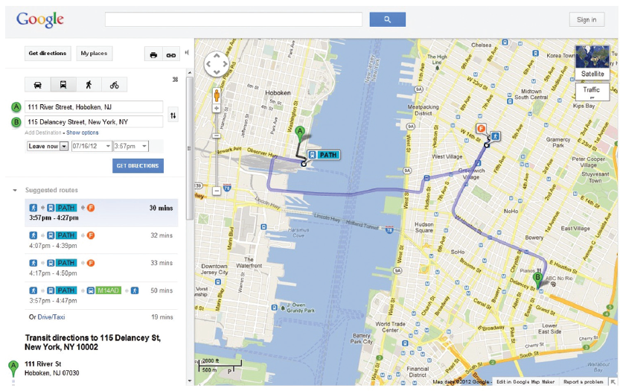
Figure 8.2: Google Maps is a Classic Example of a Mashup

Slide 22
Fundamentals of Social Computing in Business
Social Commerce: the delivery of electronic commerce activities and transactions through social computing.
Social commerce also supports social interactions and user contributions, allowing customers to participate actively in the marketing and selling of products and services in online marketplaces and communities.
-- Benefits to Customers
-- Benefits to Businesses
Notes:
Social Commerce: the delivery of electronic commerce activities and transactions through social computing. Social commerce also
supports social interactions and user contributions, allowing customers to participate actively in the marketing and selling of products and services in online marketplaces and communities.
-- Benefits to Customers
-- Benefits to

Slide 23
Social Commerce: Benefits to Customers
Better and faster vendor responses to complaints (on Twitter, Facebook, and YouTube)
Customers can assist other customers (e.g., in online forums)
Customers’ expectations can be met more fully and quickly
Customers can easily search, link, chat, and buy while staying on a social network’s page

Slide 24
Social Commerce: Benefits to Businesses
Can test new products and ideas quickly and inexpensively
Learn a lot about their customers
Identify problems quickly and lessen customer anger
Learn about customers’ experiences via rapid feedback
Increase sales when customers discuss products positively on social networking site

Slide 25
Social Commerce: Benefits to Businesses (Con’t)
Create more effective marketing campaigns and brand awareness
Use low-cost user-generated content, for example, in marketing campaigns
Obtain free advertising through viral marketing
Identify and reward influential brand advocates

Slide 26
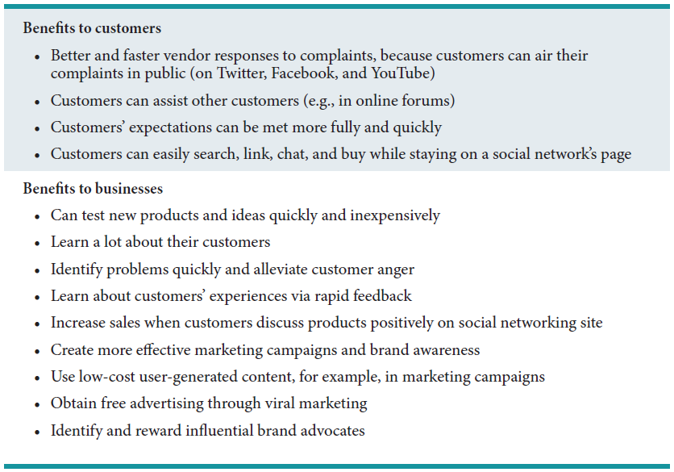
Table 8.2: Potential Benefits of Social Commerce

Slide 27
’S ABOUT BUSINESS 8.2
Trip to Europe: Cancelled
Should you be careful of what you post on Facebook? Support your answer in relation to this case.
What mistake did the parents make when they informed Dana about the settlement? Telling her at all? Not telling her about the dangers of posting details on social media?

Slide 28
Social Computing in Business: Shopping
Ratings, Reviews, and Recommendations
Group Shopping
Shopping Communities and Clubs
Social Marketplaces and Direct Sales
Peer-to-Peer Shopping Models
Notes:
Ratings, Reviews, and Recommendations: are usually available in social shopping and generally come from,
(a) Customer ratings and reviews integrated into the vendor’s Web page
(b) Expert ratings and reviews from an independent authority
(c) Sponsored reviews: paid-for reviews
(d) Conversational marketing: individuals converse via e-mail, blog, live chat, discussion groups, and tweets.
Group Shopping: Web sites such as Groupon and LivingSocial offer major discounts or special deals during a short time frame.
Shopping Communities and Clubs: host sales for their members that last just a few days and usually feature luxury brands and heavily discounted prices. These clubs tend to be exclusive and help sell luxury items without watering down the brands’ images.
Social Marketplaces and Direct Sales: act as online intermediaries that harness the power of social networks for introducing, buying, and selling products and services. A social marketplace helps members market their own creations.
Peer-to-Peer Shopping Models: are the high-tech version of oldfashioned bazaars and bartering systems. Individuals use these models to sell, buy, rent, or barter online with other individuals.
Collaborative consumption: peer-to-peer sharing or renting.

Slide 29
Social Computing in Business: Shopping
Ratings, Reviews, and Recommendations: are usually available in social shopping and generally come from,
(a) Customer ratings and reviews integrated into the
vendor’s Web page
(b) Expert ratings and reviews from an independent
authority
(c) Sponsored reviews: paid-for reviews
(d) Conversational marketing: individuals converse via e-mail, blog, live chat, discussion groups, and tweets.
Group Shopping: Web sites such as Groupon and LivingSocial offer major discounts or special deals during a short time frame.
Notes:
Ratings, Reviews, and Recommendations: are usually available in social shopping and generally come from,
(a) Customer ratings and reviews integrated into the vendor’s Web page
(b) Expert ratings and reviews from an independent authority
(c) Sponsored reviews: paid-for reviews
(d) Conversational marketing: individuals converse via e-mail, blog, live chat, discussion groups, and tweets.
Group Shopping: Web sites such as Groupon and LivingSocial offer major discounts or special deals during a short time frame.
Shopping Communities and Clubs: host sales for their members that last just a few days and usually feature luxury brands and heavily discounted prices. These clubs tend to be exclusive and help sell luxury items without watering down the brands’ images.
Social Marketplaces and Direct Sales: act as online intermediaries that harness the power of social networks for introducing, buying, and selling products and services. A social marketplace helps members market their own creations.
Peer-to-Peer Shopping Models: are the high-tech version of oldfashioned bazaars and bartering systems. Individuals use these models to sell, buy, rent, or barter online with other individuals.
Collaborative consumption: peer-to-peer sharing or renting.

Slide 30
Social Computing in Business: Shopping
Shopping Communities and Clubs: host sales for their members that last just a few days and usually feature luxury brands at heavily discounted prices. These clubs tend to be exclusive and help sell luxury items without watering down the brands’ images.
Social Marketplaces and Direct Sales: act as online intermediaries that harness the power of social networks for introducing, buying, and selling products and services. A social marketplace helps members market their own creations.
Peer-to-Peer Shopping Models: are the high-tech version of oldfashioned bazaars and bartering systems. Individuals use these models to sell, buy, rent, or barter online with other individuals.
Collaborative consumption: peer-to-peer sharing or renting.
Notes:
Ratings, Reviews, and Recommendations: are usually available in social shopping and generally come from,
(a) Customer ratings and reviews integrated into the vendor’s Web page
(b) Expert ratings and reviews from an independent authority
(c) Sponsored reviews: paid-for reviews
(d) Conversational marketing: individuals converse via e-mail, blog, live chat, discussion groups, and tweets.
Group Shopping: Web sites such as Groupon and LivingSocial offer major discounts or special deals during a short time frame.
Shopping Communities and Clubs: host sales for their members that last just a few days and usually feature luxury brands and heavily discounted prices. These clubs tend to be exclusive and help sell luxury items without watering down the brands’ images.
Social Marketplaces and Direct Sales: act as online intermediaries that harness the power of social networks for introducing, buying, and selling products and services. A social marketplace helps members market their own creations.
Peer-to-Peer Shopping Models: are the high-tech version of oldfashioned bazaars and bartering systems. Individuals use these models to sell, buy, rent, or barter online with other individuals.
Collaborative consumption: peer-to-peer sharing or renting.

Slide 31
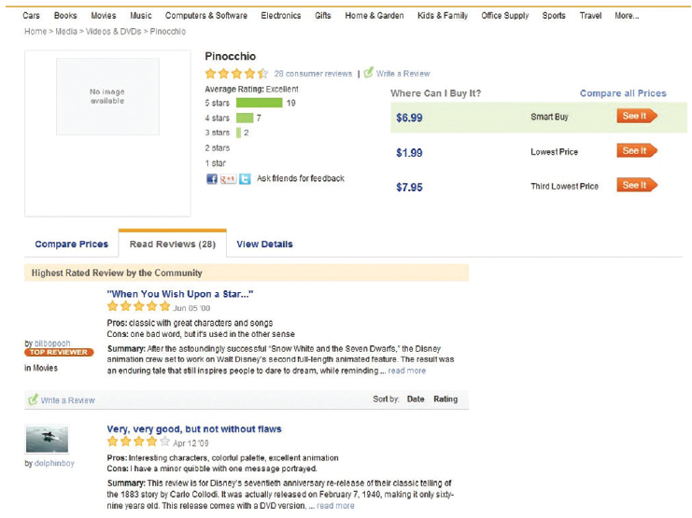
Figure 8.3: Epinions is a Web site that allows customers to rate anything from cars to music.

Slide 32
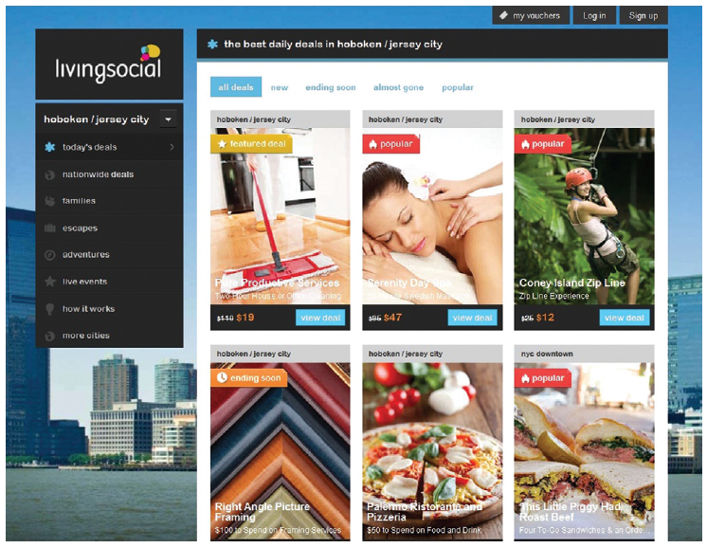
Figure 8.4: LivingSocial.com is a Popular Example of a Group Shopping Web Site.

Slide 33

Figure 8.5: Etsy.com is a Social Marketplace for all Handmade or Vintage Items.

Slide 34
’S ABOUT BUSINESS 8.3
Social Network Analysis Applied to Gangs
What other data could the Chicago Police Department add to ORCA?
What are the potential disadvantages of ORCA? Provide specific examples to support your answer.

Slide 35
Social Computing in Business: Marketing
Social Advertising: refers to the advertising formats that make use of the social context of the user viewing the ad. It is the first form of advertising to leverage forms of social influence such as peer pressure and friend recommendations and likes.
Market Research: today members of social media voluntarily provide demographics that help identify and target potential customers. Due to the open nature of social networking, merchants can easily find customers, see what they do online, and learn who their friends are.
Conversational Marketing: feedback from customers provided to companies through social computing tools (e.g., blogs, wikis, online forums, and social networking sites.
Conducting Market Research Using Social Networking: Customer sentiment expressed on Facebook, Twitter, LinkedIn and similar sites represent an incredibly valuable source of information for companies allowing them to analyze the data, conduct better advertising campaigns, improve their product design and their service offerings.
Notes:
Social Advertising: refers to the advertising formats that make use of the social context of the user viewing the ad. It is the first form of advertising to leverage forms of social influence such as peer pressure and friend recommendations and likes.
Market Research: today members of social media voluntarily provide demographics that help identify and target potential customers. Due to the open nature of social networking, merchants can easily find customers, see what they do online, and learn who their friends are.
Conversational Marketing: feedback from customers provided to companies through social computing tools (e.g., blogs, wikis, online forums, and social networking sites.
Conducting Market Research Using Social Networking: Customer sentiment expressed on Facebook, Twitter, LinkedIn and similar sites represent an incredibly valuable source of information for companies allowing them to analyze the data, conduct better advertising campaigns, improve their product design and their service offerings.

Slide 36
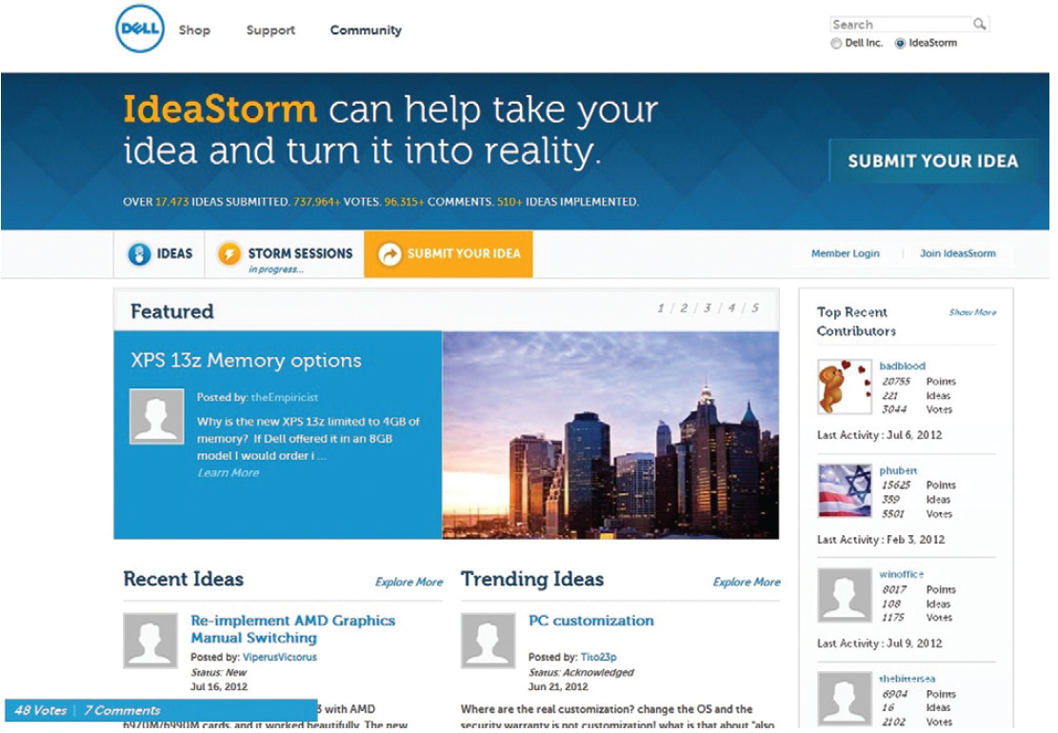
Figure 8.6: Customers Share Their Ideas and Feedback with Dell via IdeaStorm.com.

Slide 37
’S ABOUT BUSINESS 8.4
YouTube versus Television
Describe the differences in how traditional television and YouTube provide online content to audiences.
If you were the CEO of a traditional television network, how would you combat YouTube?

Slide 38
Social Computing in Business: Customer Relationship Management
How Social Computing Improves Customer Service?
Social computing has vastly altered both the expectations of customers and the capabilities of corporations in the area of customer relationship management.
Customers are now incredibly empowered as companies closely monitor negative comments and proactively involve customers to resolve problems/issues for improved customer service.
Empowered customers know how to use the wisdom and power of crowds and communities to their benefit.
Notes:
Social computing has vastly altered both the expectations of customers and the capabilities of corporations in the area of customer relationship management.
Customers are now incredibly empowered as companies closely monitor negative comments and proactively involve customers to resolve problems/issues for improved customer service.
Empowered customers know how to use the wisdom and power of crowds and communities to their benefit.

Slide 39
Social Computing in Business: Human Resource Management
Recruiting: Both recruiters and job seekers are moving to online social networks as recruiting platforms.
Employee Development: HR professionals are using enterprise social tools such as Chatter, Yammer, and Tibbr to enable, encourage, and promote employee development through relationship building by providing a platform for employees to collaborate on sales opportunities, campaigns, projects as well as simplify workflows and capture new ideas. Elearning and Etraining are employee development tools that can be leveraged through social computing.
Notes:
Recruiting: Both recruiters and job seekers are moving to online social networks as recruiting platforms.
Employee Development: HR professionals are using enterprise social tools such as Chatter, Yammer, and Tibbr to enable, encourage, and promote employee development through relationship building by providing a platform for employees to collaborate on sales opportunities, campaigns, projects as well as simplify workflows and capture new ideas. Elearning and Etraining are employee development tools that can be leveraged through social computing.

